Slide 1
Web Developement
Unit No 3: Java Servlets and XML [7 Hours]
Servlet: Servlet architecture overview, A “Hello World” servlet, Servlet generating dynamic content, Servlet life cycle, parameter data, sessions, cookies, URL rewriting, other Servlet capabilities, data storage, Servlets concurrency, databases (MySQL) and Java Servlets. XML: XML documents and vocabularies, XML declaration, XML Namespaces, DOM based XML processing, transforming XML documents, DTD: Schema, elements, attributes. AJAX: Introduction, Working of AJAX.

Slide 2
Web Developement
Servlet:
-A servlet is a Java programming language class that is used to extend the capabilities of servers that host applications accessed by means of a request-response programming model.
-Although servlets can respond to any type of request, they are commonly used to extend the applications hosted by web servers.
-For such applications, Java Servlet technology defines HTTP-specific servlet classes.
-Servlet technology is used to create a web application (resides at server side and generates a dynamic web page
-Servlet technology is robust and scalable because of java language. Before Servlet, CGI (Common Gateway Interface) scripting language was common as a server-side programming language.
-Servlet is a web component that is deployed on the server to create a dynamic web page.

Slide 3
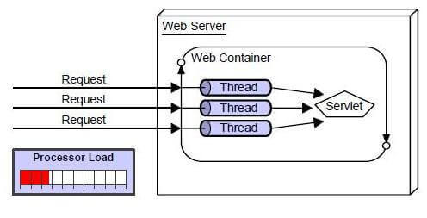
Web Developement
Advantages of Servlet:
There are many advantages of Servlet over CGI.
-The web container creates threads for handling the multiple requests to the Servlet.
- Threads have many benefits over the Processes such as they share a common memory area, lightweight, cost of communication between the threads are low. The advantages of Servlet are as follows:
Better performance: because it creates a thread for each request, not process.
Portability: because it uses Java language.
Robust: JVM manages Servlets, so we don't need to worry about the memory leak, garbage collection, etc.
Secure: because it uses java language.
Working of Servlet:→ → →

Slide 4
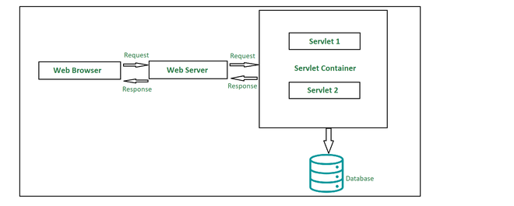
Web Developement
Talking about the types of servlets, there are primarily two types, namely:
Generic Servlets
HTTP Servlets
There are three potential ways in which we can employ to create a servlet:
Implementing Servlet Interface
Extending Generic Servlet
Extending HTTP Servlet
Components of Servlet Architecture
-Below is the high level architecture diagram of servlet. Let’s see in brief, how does each component add to the working of a servlet.

Slide 5
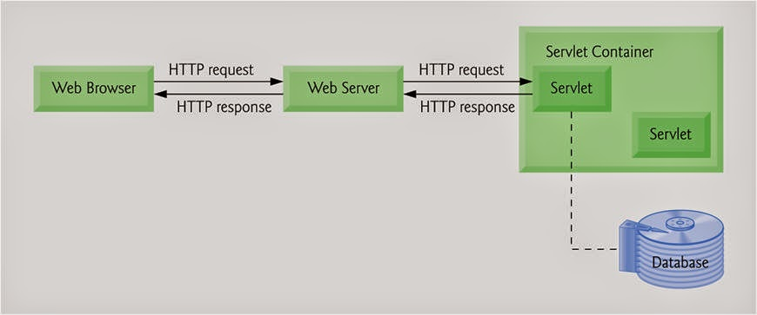
Web Developement
Servlet Architecture

Slide 6
Web Developement
1. Client
The client is primarily working as a medium who is sending out HTTP requests over to the web server and again processing the response it gets back from the server
2. Web Server
Primary job of a web server is to process the requests and responses that a user sends over time and maintain how a web user would be able to access the files that has been hosted over the server.
There are precisely two types of webservers:
Static web server 2. Dynamic web server
3. Web Container
Web container is another typical component in servlet architecture which is responsible for communicating with the servlets. Two prime tasks of a web container are:
Managing the servlet lifecycle
URL mapping

Slide 7
Web Developement
How does a Servlet Request flow?
Every servlet should override the following 3 methods namely:
init()
service()
destroy()
Following are the steps in which a request flows through a servlet which can be observed in the architecture diagram:
1) The client sends over a request.
2) The request is accepted by the web server and forwarded to the web container.
3) In order to obtain the servlet’s address, the web container traces web.xml file corresponding to the request URL pattern.
4) By the time above process takes place, the servlet should have been instantiated and initialized. If the servlet has not been instantiated and Initialized,
init() method is invoked to serve the purpose.
5) By passing ServletRequest and Response object, public service() method is called by the container.

Slide 8
Web Developement
6) In the next step, the ServletRequest and ServletResponse objects are type-casted to HttpServletRequest and HttpServletResponse objects by the public service() method.
7)Now protected service() method is called by the public service() method.
8)The protected service() method dispatches the request to the correct handler method based on the type of request.
9)When servlet container shuts down, it unloads all the servlets and calls destroy() method for each initialized servlets.

Slide 9
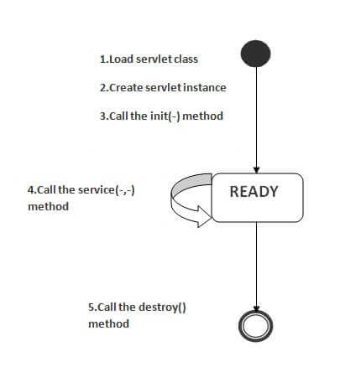
Web Developement
Life Cycle of a Servlet:
The web container maintains the life cycle of a servlet instance. Let's see the life cycle of the servlet.
Servlet class is loaded.
Servlet instance is created.
init method is invoked.
service method is invoked.
destroy method is invoked.
There are three states of a servlet: new, ready and end

Slide 10
Web Developement
Working of servlet:
-The servlet is in new state if servlet instance is created.
-After invoking the init() method, Servlet comes in the ready state.
-In the ready state, servlet performs all the tasks.
-When the web container invokes the destroy() method, it shifts to the end state.
1) Servlet class is loaded
The classloader is responsible to load the servlet class. The servlet class is loaded when the first request for the servlet is received by the web container.
2) Servlet instance is created
The web container creates the instance of a servlet after loading the servlet class. The servlet instance is created only once in the servlet life cycle.
3) init method is invoked
The web container calls the init method only once after creating the servlet instance. The init method is used to initialize the servlet. It is the life cycle method of the javax.servlet.Servlet interface.
Syntax of the init method is given below:
public void init(ServletConfig config) throws ServletException

Slide 11
Web Developement
4) service method is invoked
The web container calls the service method each time when request for the servlet is received. If servlet is not initialized, it follows the first three steps as described above then calls the service method. If servlet is initialized, it calls the service method. Notice that servlet is initialized only once.
-The syntax of the service method of the Servlet interface is given below:
public void service(ServletRequest request, ServletResponse response) throws ServletException, IOException
5) destroy method is invoked
The web container calls the destroy method before removing the servlet instance from the service. It gives the servlet an opportunity to clean up any resource for example memory, thread etc. The syntax of the destroy method of the Servlet interface is given below:
public void destroy()

Slide 12
Web Developement
Steps to create a servlet example
There are given 6 steps to create a servlet example. These steps are required for all the servers.
Here, we are going to use apache tomcat server in this example. The steps are as follows:
Create a directory structure
Create a Servlet
Compile the Servlet
Create a deployment descriptor
Start the server and deploy the project
Access the servlet

Slide 13
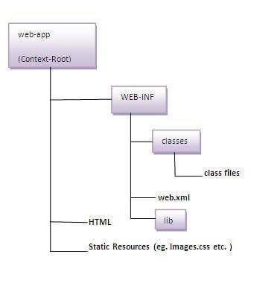
Web Developement
1)Create a directory structures
The directory structure defines that where to put the different types of files so that web container may get the information and respond to the client.
The Sun Microsystem defines a unique standard to be followed by all the server vendors. Let's see the directory structure that must be followed to create the servlet.
As you can see that the servlet class file must be in the classes folder. The web.xml file must be under the WEB-INF folder

Slide 14
Web Developement
2)Create a Servlet
There are three ways to create the servlet.
By implementing the Servlet interface
By inheriting the GenericServlet class
By inheriting the HttpServlet class
-The HttpServlet class is widely used to create the servlet because it provides methods to handle http requests such as doGet(), doPost, doHead() etc.
-In this example we are going to create a servlet that extends the HttpServlet class. In this example, we are inheriting the HttpServlet class and providing the implementation of the doGet() method.
-Notice that get request is the default request.

Slide 15
Web Developement
import javax.servlet.http.*;
import javax.servlet.*;
import java.io.*;
public class DemoServlet extends HttpServlet{
public void doGet(HttpServletRequest req,HttpServletResponse res)
throws ServletException,IOException
{
res.setContentType("text/html");//setting the content type
PrintWriter pw=res.getWriter();//get the stream to write the data //writing html in the stream
pw.println("<html><body>");
pw.println("Welcome to servlet");
pw.println("</body></html>");
pw.close();//closing the stream
}}

Slide 16
Web Developement
3)Compile the servlet:
-For compiling the Servlet, jar file is required to be loaded. Different Servers provide different jar files:
4)Create the deployment descriptor (web.xml file):
-The deployment descriptor is an xml file, from which Web Container gets the information about the servet to be invoked.
-The web container uses the Parser to get the information from the web.xml file. There are many xml parsers such as SAX, DOM and Pull
5)Start the Server and deploy the project
To start Apache Tomcat server, double click on the startup.bat file under apache-tomcat/bin directory.
Jar file | Server
1) servlet-api.jar | Apache Tomcat
2) weblogic.jar | Weblogic
3) javaee.jar | Glassfish
4) javaee.jar | JBoss

Slide 17
Web Developement
One Time Configuration for Apache Tomcat Server
You need to perform 2 tasks:
1. set JAVA_HOME or JRE_HOME in environment variable (It is required to start server).
2. Change the port number of tomcat (optional). It is required if another server is running on same port (8080).

Slide 18
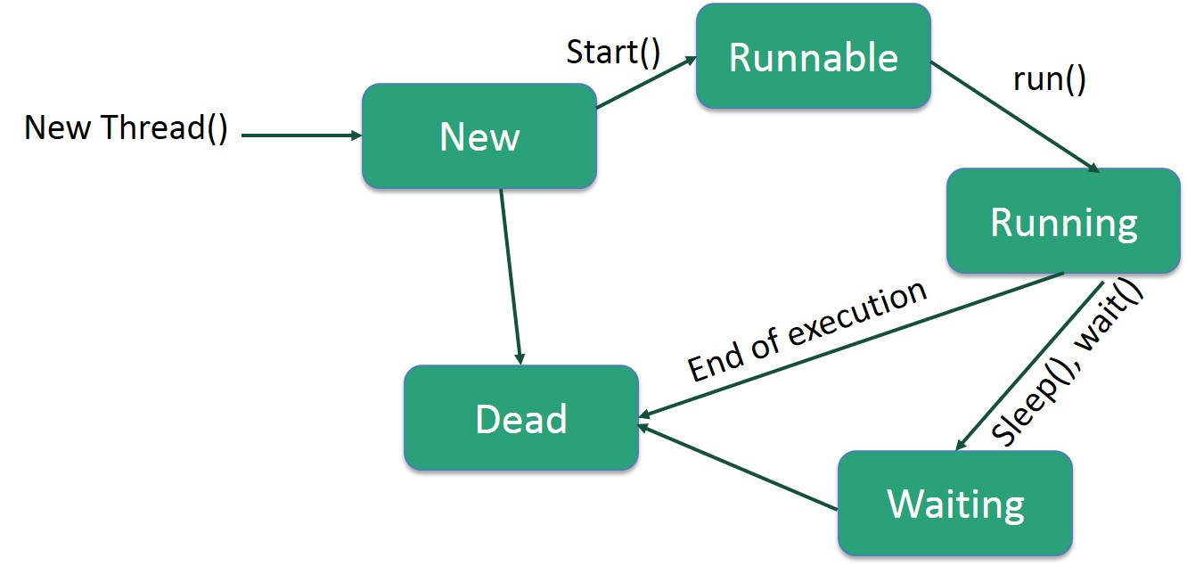
Web Developement
Life Cycle of a Thread:
- A thread goes through various stages in its life cycle.
For example, a thread is born, started, runs, and then dies.
The following diagram shows the complete life cycle of a thread.

Slide 19
Web Developement
Following are the stages of the life cycle :
New − A new thread begins its life cycle in the new state. It remains in this state until the program starts the thread. It is also referred to as a born thread.
Runnable − After a newly born thread is started, the thread becomes runnable. A thread in this state is considered to be executing its task.
Waiting − Sometimes, a thread transitions to the waiting state while the thread waits for another thread to perform a task. A thread transitions back to the runnable state only when another thread signals the waiting thread to continue executing.
Timed Waiting − A runnable thread can enter the timed waiting state for a specified interval of time. A thread in this state transitions back to the runnable state when that time interval expires or when the event it is waiting for occurs.
Terminated (Dead) − A runnable thread enters the terminated state when it completes its task or otherwise terminates.

Slide 20
Web Developement
One Time Configuration for Apache Tomcat Server
You need to perform 2 tasks:
1. set JAVA_HOME or JRE_HOME in environment variable (It is required to start server).
2. Change the port number of tomcat (optional). It is required if another server is running on same port (8080).

Slide 21
Web Developement
To start with interfacing Java Servlet Program with JDBC Connection:
Proper JDBC Environment should set-up along with database creation.
To do so, download the mysql-connector.jar file from the internet,
As it is downloaded, move the jar file to the apache-tomcat server folder,
Place the file in lib folder present in the apache-tomcat directory.
To start with the basic concept of interfacing:

Slide 22
Web Developement
Step 1: Creation of Database and Table in MySQL
As soon as jar file is placed in the folder, create a database and table in MySQL,
mysql> create database demoprj;
mysql> use demoprj Database changed
mysql> create table demo(id int(10), string varchar(20));
mysql> desc demo;
--------+-------------+------+-----+---------+-------+
| Field | Type | Null | Key | Default | Extra |
+--------+-------------+------+-----+---------+-------+
| id | int(10) | YES | | NULL | |
| string| varchar(20) | YES | | NULL | |
+--------+-------------+------+-----+---------+-------+

Slide 23
Web Developement
Step 2: Implementation of required Web-pages: -Create a form in HTML file, where take all the inputs required to insert data into the database. Specify the servlet name in it, with the POST method as security is important aspects in database connectivity.
<!DOCTYPE html>
<html> <head>
<title>Insert Data</title>
</head> <body>
<!-- Give Servlet reference to the form as an instances
GET and POST services can be according to the problem statement-->
<form action="./InsertData" method="post">
<p>ID:</p>
<!-- Create an element with mandatory name attribute,
so that data can be transfer to the servlet using getParameter() -->
<input type="text" name="id"/>
<br/>
<p>String:</p>
<input type="text" name="string"/>
<br/><br/><br/>
<input type="submit"/>
</form>
</body> </html>

Slide 24
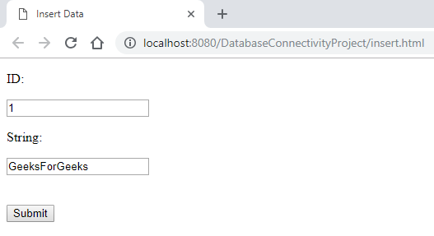
Web Developement
Output:
Submit the data (with validation) as all the required data are inserted.
Step 3: Creation of Java Servlet program with JDBC ConnectionTo create a
JDBC Connection steps are
Import all the packages
Register the JDBC Driver
Open a connection
Execute the query, and retrieve the result
Clean up the JDBC Environment

Slide 25
Web Developement
Create a separate class to create a connection of database, as it is a lame process to writing the same code snippet in all the program. Create a .java file which returns a Connection object.
import java.sql.Connection;
import java.sql.DriverManager;
import java.sql.SQLException;
// This class can be used to initialize the database connection
public class DatabaseConnection {
protected static Connection initializeDatabase()
throws SQLException, ClassNotFoundException
{
// Initialize all the information regarding
// Database Connection
String dbDriver = "com.mysql.jdbc.Driver";
String dbURL = "jdbc:mysql:// localhost:3306/";
// Database name to access
String dbName = "demoprj";
String dbUsername = "root";
String dbPassword = "root";
Class.forName(dbDriver);
Connection con = DriverManager.getConnection(dbURL + dbName,
dbUsername,
dbPassword);
return con;
} }

Slide 26
Web Developement
Step 4: To use this class method, create an object in Java Servlet program
Below program shows Servlet Class which create a connection and insert the data in the demo table,

Slide 27
Web Developement
import java.io.IOException;
import java.io.PrintWriter;
import java.sql.Connection;
import java.sql.PreparedStatement;
import javax.servlet.ServletException;
import javax.servlet.annotation.WebServlet;
import javax.servlet.http.HttpServlet;
import javax.servlet.http.HttpServletRequest;
import javax.servlet.http.HttpServletResponse;
// Import Database Connection Class file
import code.DatabaseConnection;
// Servlet Name
@WebServlet("/InsertData")
public class InsertData extends HttpServlet {
private static final long serialVersionUID = 1L;
protected void doPost(HttpServletRequest request,
HttpServletResponse response)
throws ServletException, IOException
{
try {

Slide 28
Web Developement
try {
// Initialize the database
Connection con = DatabaseConnection.initializeDatabase();
// Create a SQL query to insert data into demo table
// demo table consists of two columns, so two '?' is used
PreparedStatement st = con
.prepareStatement("insert into demo values(?, ?)");
// For the first parameter,
// get the data using request object
// sets the data to st pointer
st.setInt(1, Integer.valueOf(request.getParameter("id")));
// Same for second parameter
st.setString(2, request.getParameter("string"));
// Execute the insert command using executeUpdate()
// to make changes in database
st.executeUpdate();
// Close all the connections
st.close();
con.close();

Slide 29
Web Developement
// Get a writer pointer
// to display the successful result
PrintWriter out = response.getWriter();
out.println("<html><body><b>Successfully Inserted"
+ "</b></body></html>");
}
catch (Exception e) {
e.printStackTrace();
}
}
}

Slide 30
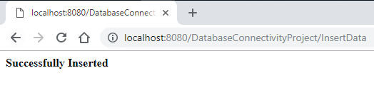
Web Developement
Step 5: Get the data from the HTML fileTo get the data from the HTML file, the request object is used which calls getParameter() Method to fetch the data from the channel. After successful insertion, the writer object is created to display a success message.
After insertion operation from Servlet, data will be reflected in MySQL Database
Output:

Slide 31
Web Developement
Concurrency in Servlets:
-A Java servlet container or web server is multithreaded and multiple requests to the same servlet may be executed at the same time. Therefore, we need to take concurrency into consideration while writing servlet.
-As we knew that one and only one instance of Servlet gets created and for every new request , Servlet Container spawn a new thread to execute doGet() or doPost() methof of a servlet.
-

Slide 32
Web Developement
Extensible Markup Language:
The Extensible Markup Language (XML) is a simple text-based format for representing structured information: documents, data, configuration, books, transactions, invoices, and much more.
- XML tags are not predefined. You must define your own tags.
- XML is platform independent and language independent.
What is XML Used For?
XML is one of the most widely-used formats for sharing structured information today: between programs, between people, between computers and people, both locally and across networks.
Platform Independent and Language Independent:
The main benefit of xml is that you can use it to take data from a program like Microsoft SQL, convert it into XML then share that XML with other programs and platforms.
You can communicate between two platforms which are generally very difficult.

Slide 33
Web Developement
Features and Advantages of XML:
XML is widely used in the era of web development. It is also used to simplify data storage and data sharing.
1) XML separates data from HTML:
If you need to display dynamic data in your HTML document, it will take a lot of work to edit the HTML each time the data changes.
With XML, data can be stored in separate XML files. This way you can focus on using HTML/CSS for display and layout, and be sure that changes in the underlying data will not require any changes to the HTML.
2) XML simplifies data sharing:
In the real world, computer systems and databases contain data in incompatible formats.
XML data is stored in plain text format. This provides a software- and hardware-independent way of storing data.
3) XML simplifies data transport:
One of the most time-consuming challenges for developers is to exchange data between incompatible systems over the Internet.
Exchanging data as XML greatly reduces this complexity, since the data can be read by different incompatible applications.

Slide 34
Web Developement
4) XML simplifies Platform change:
Upgrading to new systems (hardware or software platforms), is always time consuming. Large amounts of data must be converted and incompatible data is often lost.
This makes it easier to expand or upgrade to new operating systems, new applications, or new browsers, without losing data.
5) XML increases data availability:
Different applications can access your data, not only in HTML pages, but also from XML data sources.
With XML, your data can be available to all kinds of "reading machines" (Handheld computers, voice machines, news feeds, etc), and make it more available for blind people, or people with other disabilities.
6) XML can be used to create new internet languages:
A lot of new Internet languages are created with XML.
Examples:
XHTML:
WSDL for describing available web services
WAP and WML as markup languages for handheld devices
RSS languages for news feeds
RDF and OWL for describing resources and ontology
SMIL for describing multimedia for the web

Slide 35
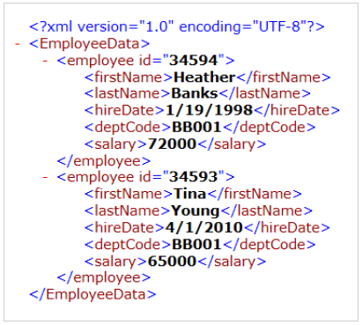
Web Developement
Example of XML Document
XML documents uses a self-describing and simple syntax:
<?xml version="1.0" encoding="ISO-8859-1"?>
<note>
<to>Student’s</to>
<from>HOD</from>
<heading>Reminder</heading>
<body>Attend Lecture Regularly</body>
</note>
-Follow the steps below to read a XML file and load the data into a RowSet.

Slide 36
Web Developement
One Time Configuration for Apache Tomcat Server
You need to perform 2 tasks:
1. set JAVA_HOME or JRE_HOME in environment variable (It is required to start server).
2. Change the port number of tomcat (optional). It is required if another server is running on same port (8080).

Slide 37
Web Developement
The following table illustrates the data contained in the RowSet variable created from the XML Read task:
${myData} RowSet Variable
${myData[1]} | ${myData[2]} | ${myData[3]} | ${myData[4]} | ${myData[5]} | ${myData[6]}
34594 | Heather | Banks | 1998-01-19 | BB001 | 72000
34593 | Tina | Young | 2010-04-01 | BB001 | 65000

Slide 38
Web Developement
XML documents:
-XML documents are strictly text files.
-In the context of data transport, the phrase "XML document" refers to a file or data stream containing any form of structured data.
-Examples include e-commerce transactions, server APIs, mathematical equations, customer information, and inventory status.
-XML documents contain only markup and content.
-All of the rules and semantics of the document are defined by the applications that process them.
-Like HTML documents, XML documents can be displayed in a Web browser.
-XML documents are said to be either "well-formed" or "valid.“
Well-formed documents follow all of the XML rules for a document–for example, for every start tag, there is a corresponding end tag.
Valid XML documents are well-formed, but they also contain a document type definition (DTD), and they obey the constraints of that definition.

Slide 39
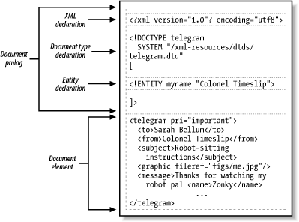
Web Developement
Parts of an XML document:

Slide 40
Web Developement
XML vocabularies:
-XML vocabularies are the elements used in particular applications or data formats - the definitions of the meanings of those formats.
-For example, in CDF, element names such as <SCHEDULE>, <CHANNEL>, and <ITEM> make up the vocabulary for describing collections of pages, when these pages should be downloaded, etc.
- Vocabularies, along with the structural relationships between the elements, are defined in XML DTDs or XML schema

Slide 41
Web Developement
XML Namespaces provide a method to avoid element name conflicts.
XML Namespace Declaration
An XML namespace is declared using the reserved XML attribute. This attribute name must be started with "xmlns".
Let's see the XML namespace syntax

Slide 42
Web Developement
XML Document Object Model (DOM):
-The XML Document Object Model (DOM) class is an in-memory representation of an XML document.
-The DOM allows you to programmatically read, manipulate, and modify an XML document.
The XmlReader class also reads XML; however, it provides non-cached, forward-only, read-only access.
This means that there are no capabilities to edit the values of an attribute or content of an element, or the ability to insert and remove nodes with the XmlReader.
Editing is the primary function of the DOM.
It is the common and structured way that XML data is represented in memory, although the actual XML data is stored in a linear fashion when in a file or coming in from another object.

Slide 43
Web Developement
The following is XML data.
<?xml version="1.0"?>
<books>
<book>
<author>Carson</author>
<price format="dollar">31.95</price>
<pubdate>05/01/2001</pubdate>
</book>
<pubinfo>
<publisher>MSPress</publisher>
<state>WA</state>
</pubinfo>
</books>

Slide 44
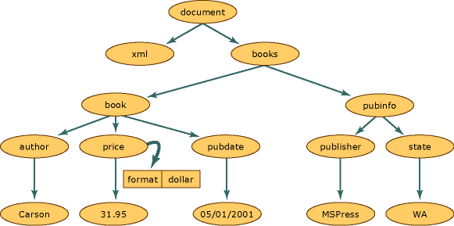
Web Developement
-The following illustration shows how memory is structured when this XML data is read into the DOM structure.

Slide 45
Web Developement
-In the XML document structure, each circle in this illustration represents a node, which is called an XmlNode object.
-The XmlNode object is the basic object in the DOM tree.
Both XmlNode and XmlDocument have performance and usability enhancements and have methods and properties to:
1. Access and modify nodes specific to the DOM, such as element nodes, entity reference nodes, and so on.
2. Retrieve entire nodes, in addition to the information the node contains, such as the text in an element node.
Node objects have a set of methods and properties, as well as basic and well-defined characteristics. Some of these characteristics are:
Nodes have a single parent node, a parent node being a node directly above them. The only nodes that do not have a parent is the Document root, as it is the top-level node and contains the document itself and document fragments.
Most nodes can have multiple child nodes, which are nodes directly below them.

Slide 46
Web Developement
The following is a list of node types that can have child nodes.
Document
DocumentFragment
EntityReference
Element
Attribute
-The XmlDeclaration, Notation, Entity, CDATASection, Text, Comment, ProcessingInstruction, and DocumentType nodes do not have child nodes.
- Nodes that are at the same level, represented in the diagram by the book and pubinfo nodes, are siblings.
-

Slide 47
Web Developement
Accessing Nodes:
You can access a node in three ways:
By using the getElementsByTagName() method
-The getElementsByTagName() Method
getElementsByTagName() returns all elements with a specified tag name.
Syntax: node.getElementsByTagName("tagname");

Slide 48
Web Developement
-Navigating Node Relationships:
The following code navigates the node tree using the node relationships:
x = xmlDoc.getElementsByTagName("book")[0]; xlen = x.childNodes.length; y = x.firstChild; txt = ""; for (i = 0; i <xlen; i++) { // Process only element nodes (type 1) if (y.nodeType == 1) { txt += y.nodeName + "<br>"; } y = y.nextSibling; }

Slide 49
Web Developement
Example explained:
-Suppose you have loaded "books.xml" into xmlDoc
-Get the child nodes of the first book element
-Set the "y" variable to be the first child node of the first book element
-For each child node (starting with the first child node "y"):
-Check the node type. If the node type is "1" it is an element node
-Output the name of the node if it is an element node
-Set the "y" variable to be the next sibling node, and run through the loop again.

Slide 50
Web Developement
Transforming XML documents:
-The standard way to transform XML data into other formats is by Extensible Stylesheet Language Transformations (XSLT).
-You can use the built-in XSLTRANSFORM function to convert XML documents into HTML, plain text, or different XML schemas.
- XSLT uses stylesheets to convert XML into other data formats
-XML is so flexible that several different schemas are often used even in the same application domain.
- To interchange XML documents between two parties, it is necessary to transform XML documents into ones that conform to the schema of a partner.

Slide 51
Web Developement
What is DTD
-DTD stands for Document Type Definition.
-It defines the legal building blocks of an XML document. It is used to define document structure with a list of legal elements and attributes.
-A document type definition (DTD) provides you with the means to validate XML files against a set of rules.
-When you create a DTD file, you can specify rules that control the structure of any XML files that reference the DTD file.
-A DTD can contain declarations that define elements, attributes, notations, and entities for any XML files that reference the DTD file.
- It also establishes constraints for how each element, attribute, notation, and entity can be used within any of the XML files that reference the DTD file.
-Its main purpose is to define the structure of an XML document. It contains a list of legal elements and define the structure with the help of them.

Slide 52
Web Developement
What is DTD
- Before proceeding with XML DTD, you must check the validation. An XML document is called "well-formed" if it contains the correct syntax.
-A well-formed and valid XML document is one which have been validated against DTD.
-Visit http://www.xmlvalidation.com to validate the XML file.

Slide 53
Web Developement
Valid and well-formed XML document with DTD:
employee.xml
<?xml version="1.0"?>
<!DOCTYPE employee SYSTEM "employee.dtd">
<employee>
<firstname>vimal</firstname>
<lastname>jaiswal</lastname>
<email>vimal@javatpoint.com</email>
</employee>
In the above example, the DOCTYPE declaration refers to an external DTD file. The content of the file is shown in below paragraph.
employee.dtd

Slide 54
Web Developement
Valid and well-formed XML document with DTD:
:<!ELEMENT employee (firstname,lastname,email)>
<!ELEMENT firstname (#PCDATA)>
<!ELEMENT lastname (#PCDATA)>
<!ELEMENT email (#PCDATA)>
Declaring Attributes:
An attribute declaration has the following syntax:
<!ATTLIST element-name attribute-name attribute-type attribute-value> DTD example: <!ATTLIST payment type CDATA "check"> XML example: <payment type="check" />

Slide 55
Web Developement
The attribute-type can be one of the following:
ype | Description
CDATA | Character Data (text that doesn't contain markup)
ENTITY | The name of an entity (which must be declared in the DTD)
ENTITIES | A list of entity names, separated by whitespaces. (All entities must be declared in the DTD)
Enumerated | A list of values. The value of the attribute must be one from this list.
ID | A unique ID or name. Must be a valid XML name.
IDREF | Represents the value of an ID attribute of another element.
IDREFS | Represents multiple IDs of elements, separated by whitespace.
NMTOKEN | A valid XML name.
NMTOKENS | A list of valid XML names, separated by whitespace.
NOTATION | A notation name (which must be declared in the DTD).

Slide 56
Web Developement
Ajax (Asynchronous Javascript and XML)
It is used to communicate with the server without refreshing the web page and thus increasing the user experience and better performance.
How does it work?
AJAX cannot work independently. It is used in combination with other technologies to create interactive webpages.
There are two types of requests synchronous as well as asynchronous.
Synchronous requests are the one which follows sequentially i.e if one process is going on and in the same time another process wants to be executed, it will not be allowed that means the only one process at a time will be executed.
This is not good because in this type most of the time CPU remains idle such as during I/O operation in the process which are the order of magnitude slower than the CPU processing the instructions.
Thus to make the full utilization of the CPU and other resources use asynchronous calls.

Slide 57
Web Developement
AJAX is Based on Open Standards:
AJAX is based on the following open standards −
Browser-based presentation using HTML and Cascading Style Sheets (CSS).
Data is stored in XML format and fetched from the server.
Behind-the-scenes data fetches using XMLHttpRequest objects in the browser.
JavaScript to make everything happen

Slide 58
Web Developement
AJAX Example:
<!DOCTYPE html> <html> <body> <div id="demo"> <h2>Let AJAX change this text</h2> <button type="button" onclick="loadDoc()">Change Content</button> </div> </body> </html>

Slide 59
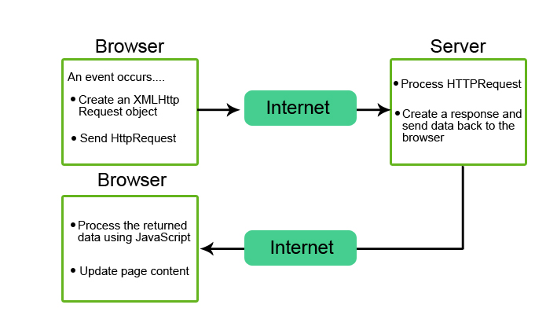
Web Developement
How AJAX Works:

Slide 60
Web Developement
How AJAX Works:
AJAX comprises the following technologies:
XHTML and CSS – for presenting the information.
The Document Object Model (DOM) – for the dynamic display data and its interaction.
XML, HTML, and XSLT – for data interchange and manipulation. However, many developers have replaced XML with JSON since it originated from JavaScript.
XMLHttpRequest object – allows asynchronous communication with the web server.
JavaScript – the programming language that links all these web technologies.

Slide 61
Web Developement
How AJAX Works: Comparison table:
Conventional model | AJAX model
The browser sends an HTTP request to the server. | The browser creates a JavaScript call, which then creates a new XMLHttpRequest object.
The web server receives and processes the request. | The new XMLHttpRequest object transfers data between the browser and the web server in an XML format.
The web server sends the requested data to the browser. | The XMLHttpRequest object sends a request for the updated page data to the web server. Subsequently, the latter processes the request and sends it back to the browser.
The browser receives the data from the server and reloads it as an HTML page. Users have to wait until it finishes loading. Therefore, the conventional model increases the load on the server and is more time-consuming. | The browser uses JavaScript to process the response and displays the updated content directly on the HTML page without reloading.

Slide 62
Web Developement
How AJAX Works:
An event occurs in a web page (the page is loaded, a button is clicked)
2. An XMLHttpRequest object is created by JavaScript
3. The XMLHttpRequest object sends a request to a web server
4. The server processes the request
5. The server sends a response back to the web page
6. The response is read by JavaScript
7. Proper action (like page update) is performed by JavaScript

